Slide 1

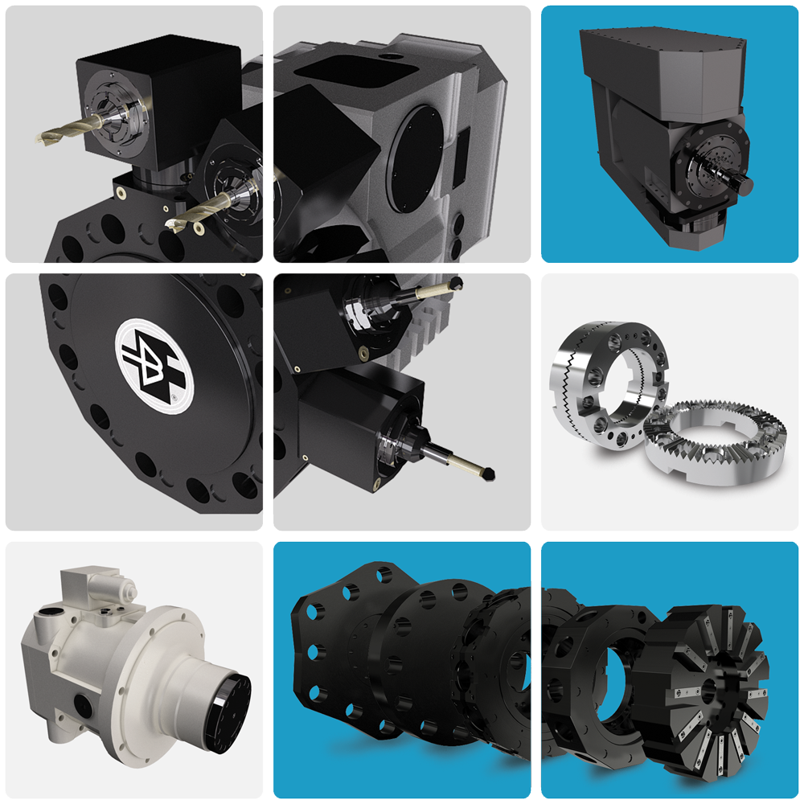

Slide 2

Baruffaldi S.p.a
Products
Machine tool components division
Electromechanical and servo turrets
Two-speed gearboxes
Y and B axes
Toolholders discs, toolholders
driven tool and rings
2

Slide 3
Electromechanical and Servo Turrets
Why choosing Baruffaldi
simple design, to grant high reliability
hydraulic and pneumatic versions are mechanically fully interchangeable
intrinsically safe products (turrets remain locked in case of power loss)
proper dimensioning of the live tool gearings
live tool clutch with backlash free front teethes (Hirth type), for the transmission
of high torques.
no live tool clutch indexing requested
live tool transmission possible with different ratio (not only 1:1)
external live tool motors, to match any machine CNC system
BMT versions available
Turrets
3

Slide 4
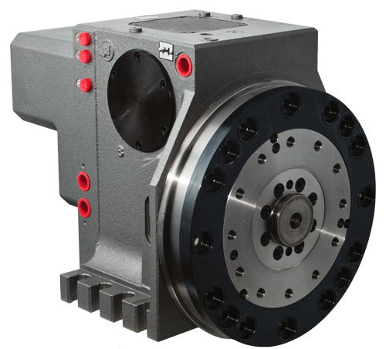
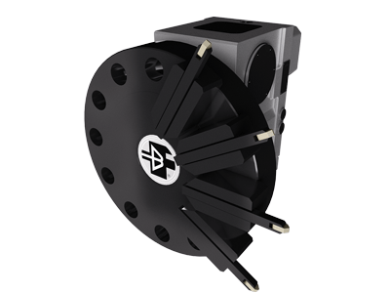
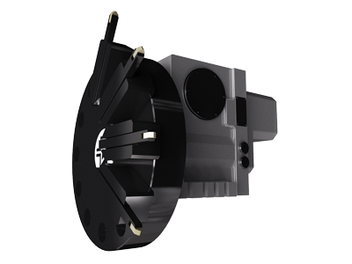
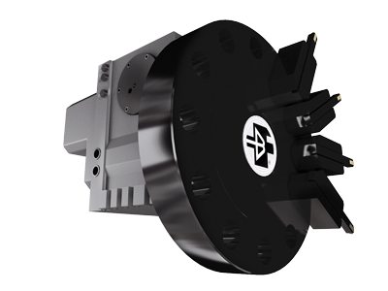
Turrets controlled by servo-motor
Description
TB type turrets rotate thanks to a BRUSHLESS SERVO-MOTOR, controlled by a new generation drive. Thanks to this new combination, positioning is quick and smooth.
Turret locking is achieved by means of Belleville washers, ensuring high stiffness and safety.
A pneumatic actuator (standard) or hydraulic (on request) locks/unlocks the turret.
Different position numbers and inertia values can be set.
Main characteristics:
Very high rotating speed and minimum indexing times
Locking and unlocking without axial movement
Bi-directional rotation
Absolute positioning
Positioning feedback
Lifetime lubrication
Spring locking mechanism ensures turret clamping even in case of power failure
Possibility to perform locking and unlocking of the turret with hydraulic or pneumatic systems
TB series
4

Slide 5
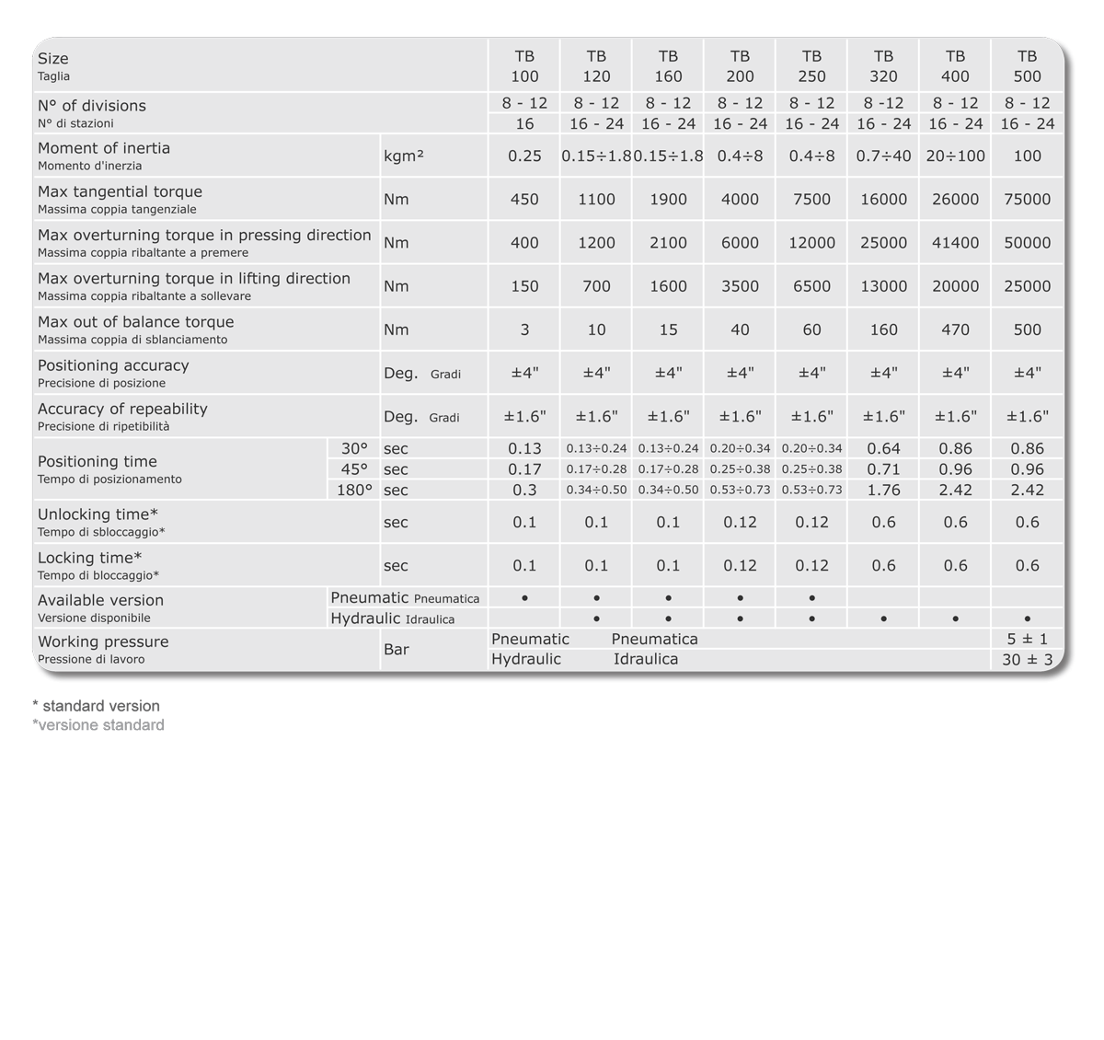
Turrets controlled by servo-motor
Technical data
TB series
5

Slide 6
Turrets controlled by servo-motor
Technical section
TB series
6

Slide 7
Turrets controlled by servo-motor
TB 500
TB series
7

Slide 8
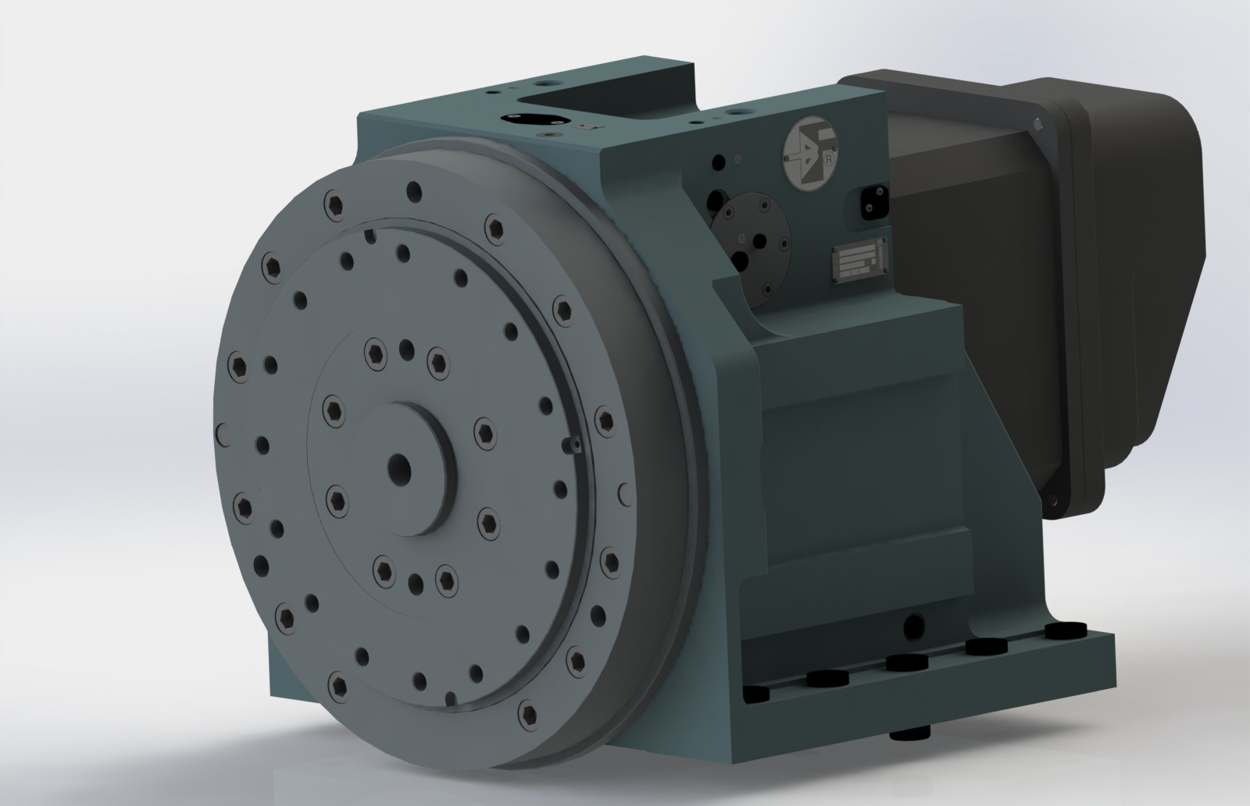
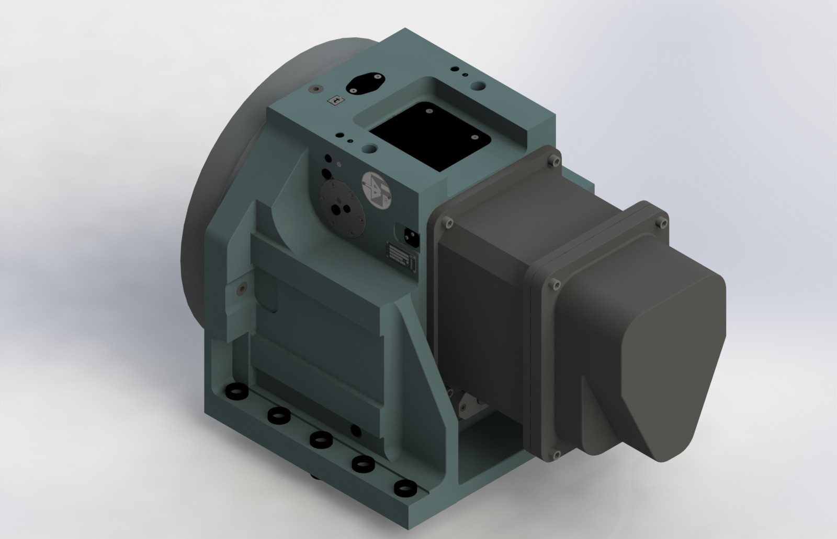
Turrets controlled by servo-motor
TB 500
TB series
8

Slide 9
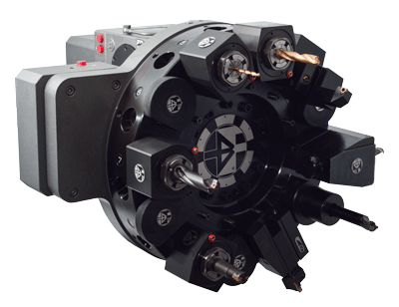
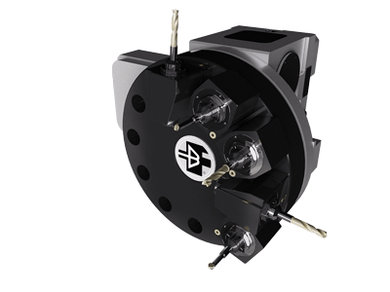
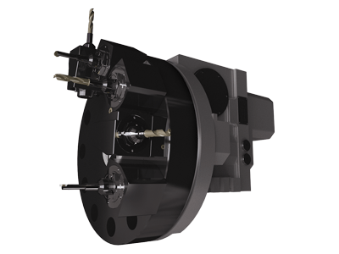
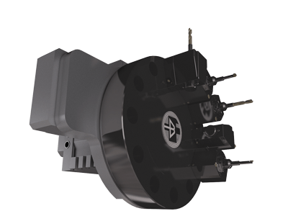
Axial driven tools turrets for tool-holders as per ISO 10889 norms
Description
Turrets with rotating tools with external modular driven tool system, which is applied externally on the TB standard turrets.
No live tool clutch orientation is required, thanks to automatic engagement and disengagement, helping dead times saving.
Discs according to ISO 10889 (ex DIN 69880) norms used.
All disc positions can be used either for fixed or for live tool.
Compact overall dimensions of the driven tool system do not effect the working capacity of the lathe.
Main characteristics:
Very high rotating speed and minimum indexing times
Locking and unlocking without axial movement
Bi-directional rotation
Oil lubrication of turret and power tool system
Double proximity switch for the engagement control
High rigidity, due to the new design
Absolute very accurate positioning
Easy maintenance
Wide range sizes and possibility to use 8-12-16-24 position discs
TBMA series
9

Slide 10
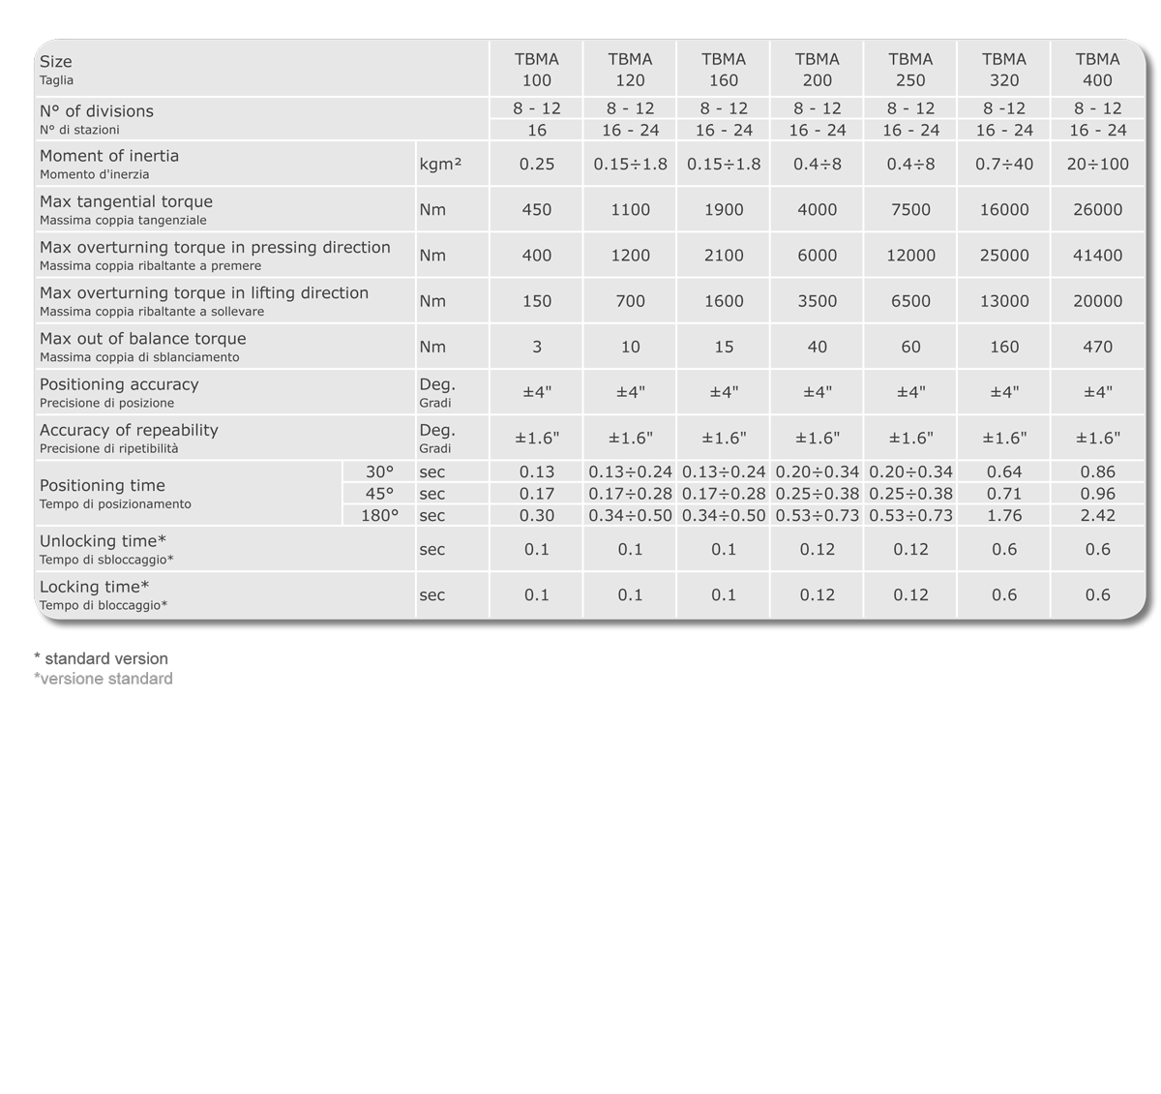
Axial driven tools turrets for tool-holders as per ISO 10889 norms
Technical data
TBMA series
10

Slide 11
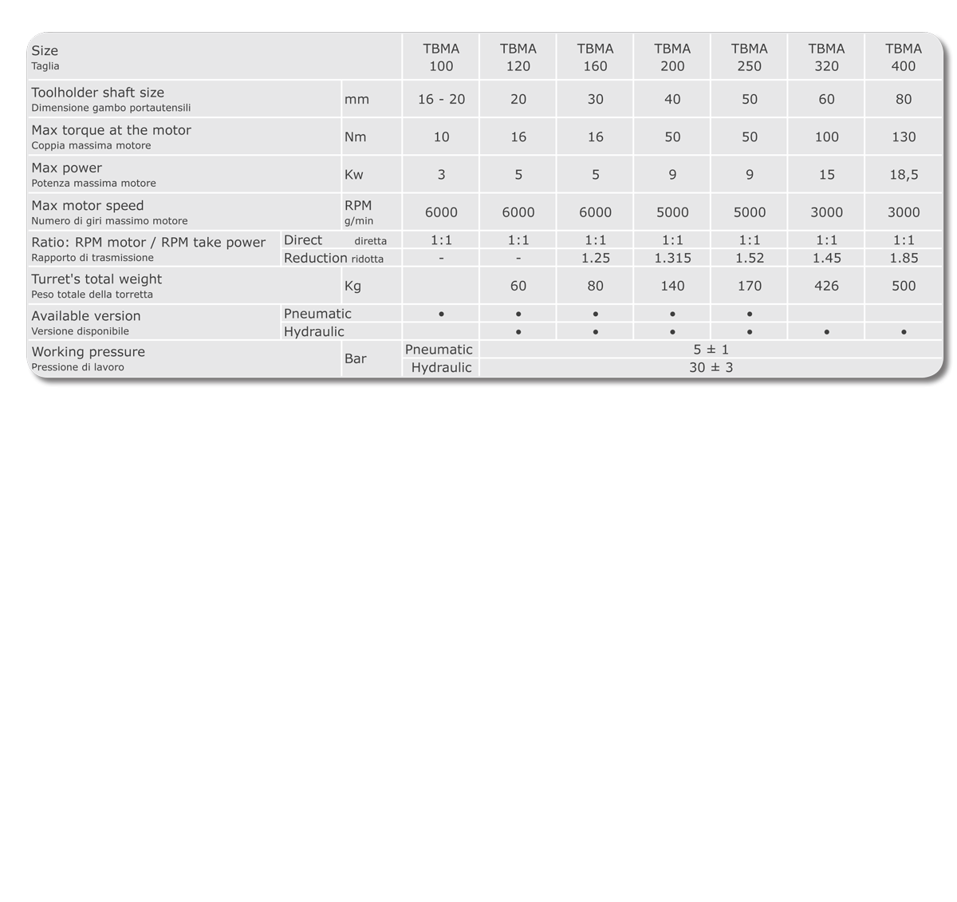
Axial driven tools turrets for tool-holders as per ISO 10889 norms
Technical data power tools
TBMA series
11

Slide 12
Axial driven tools turrets for tool-holders as per ISO 10889 norms
Technical section
TBMA series
12

Slide 13
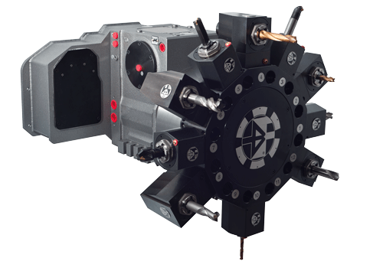
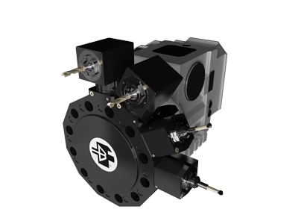
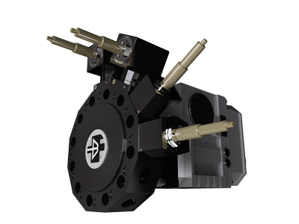
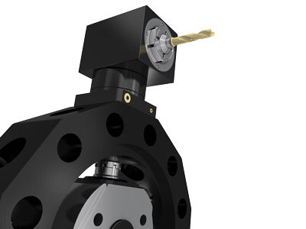
Radial driven tools turrets for tool-holders as per ISO 10889 norms
Description
Baruffaldi has developed new turrets with rotating tools with internal driven tool system type TBMR. The tools are located on discs with radial seat as per ISO 10889 (ex DIN 69880) norms.
Only the tool in working position is driven and every position on the tooldisc can receive toolholders either with fixed or with live tools. Turret main characteristic are very high
speed and automatic engagement and disengagement of rotating tool during turret indexing cycle, extended neck useful for back machining operations, strong housing and high flexibility.
Main characteristics:
Very high rotating speed and minimum indexing times
Locking and unlocking without axial movement
Bi-directional rotation
Oil lubrication of turret and power tool system
Double proximity for engagement control
High rigidity, due to the new design
Absolute positioning
Very accurate positioning
Easy maintenance
Wide range 120, 160, 200, 250, 320
Possibility to use 8-12-16-24 position discs
TBMR-VDI series
13

Slide 14
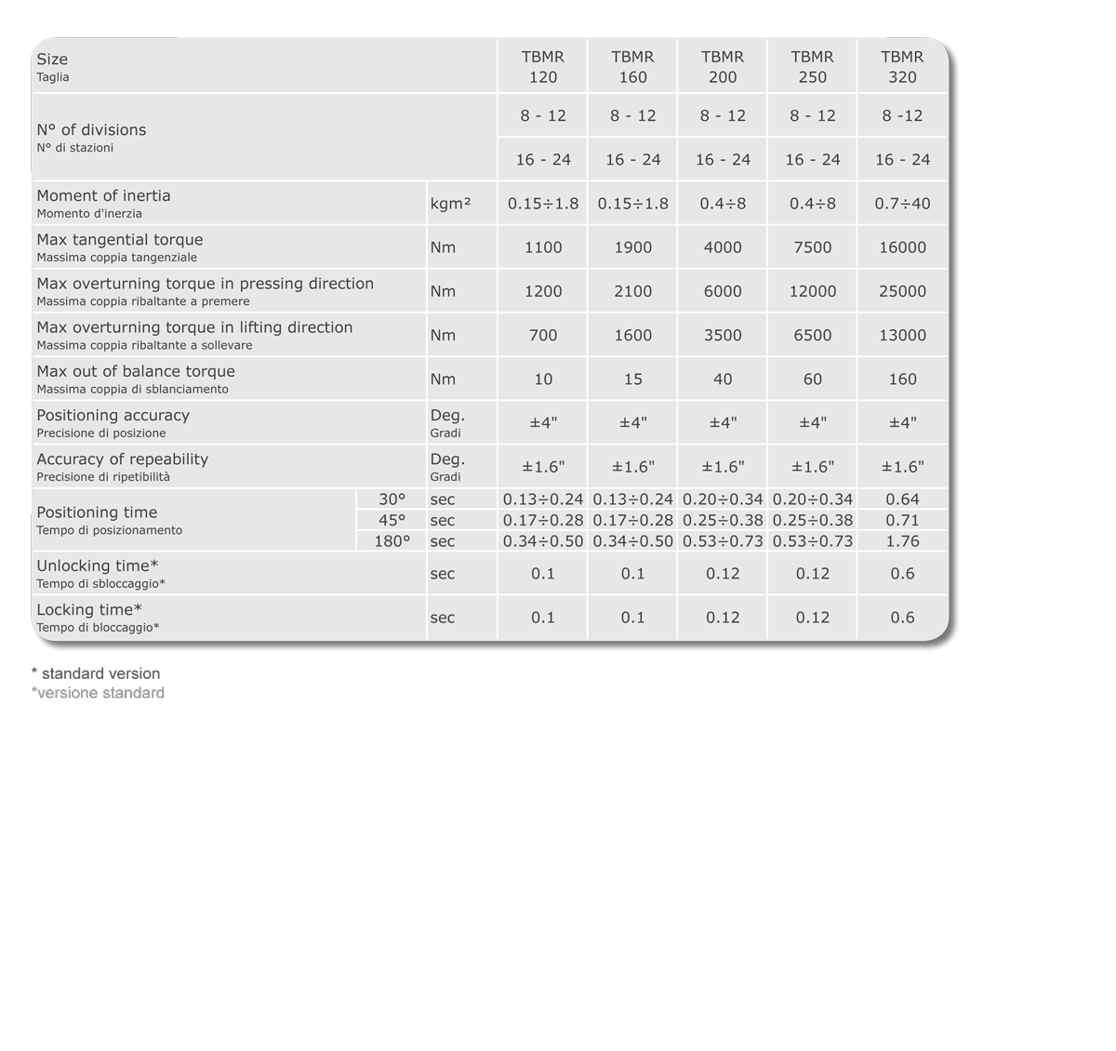
Radial driven tools turrets for tool-holders as per ISO 10889 norms
Technical data
TBMR-VDI series
14

Slide 15
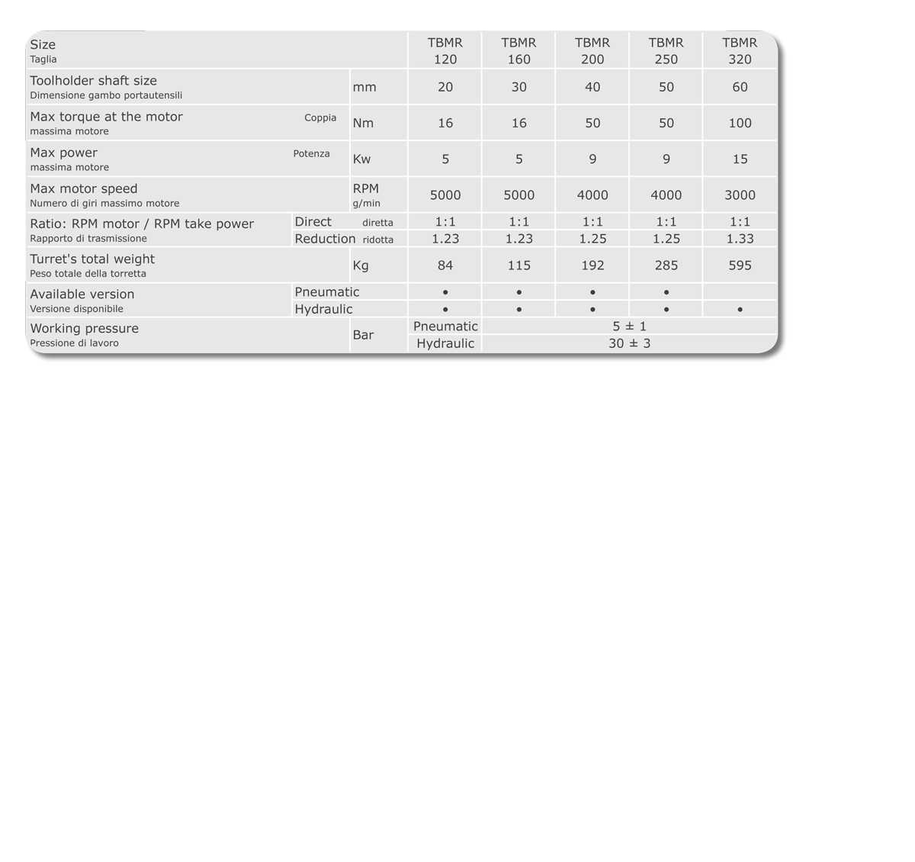
Radial driven tools turrets for tool-holders as per ISO 10889 norms
Technical data power tools
TBMR-VDI series
15

Slide 16
Radial driven tools turrets for tool-holders as per ISO 10889 norms
Technical section
TBMR-VDI series
16

Slide 17
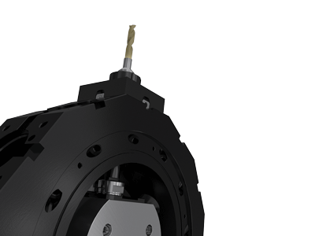
Radial driven tools turrets for tool-holders series BMT
Description
Thanks to the experience gained in more than 30 years activity in the design and production of turrets for the positioning of the tools on CNC la- thes. Baruffaldi has developed new turrets with internal driven tools system type TBMR.
The static and rotating toolhorders are located on discs with radial seats type BMT. The rotating toolholders use a take power, as per DIN norms 1809. Only the tool in the working position is driven and every position on the tooldisc can receive either toolholders with rotating or fixed tools.
Main characteristics:
Very high rotating speed and minimum indexing times
Locking and unlocking without axial movement
Bi-directional rotation
Oil lubrication of turret and power tool system
BMT coupling (Base Mounted Tool holder) 45-55- 65-75-85
High rigidity, due to the new design
Easy alignment thanks to the key present on the
BMT tool holder
Absolute positioning
Very simple & reliable take power
Very accurate positioning thanks to BMT toolholders
Easy maintenance
TBMR-BMT series
17

Slide 18
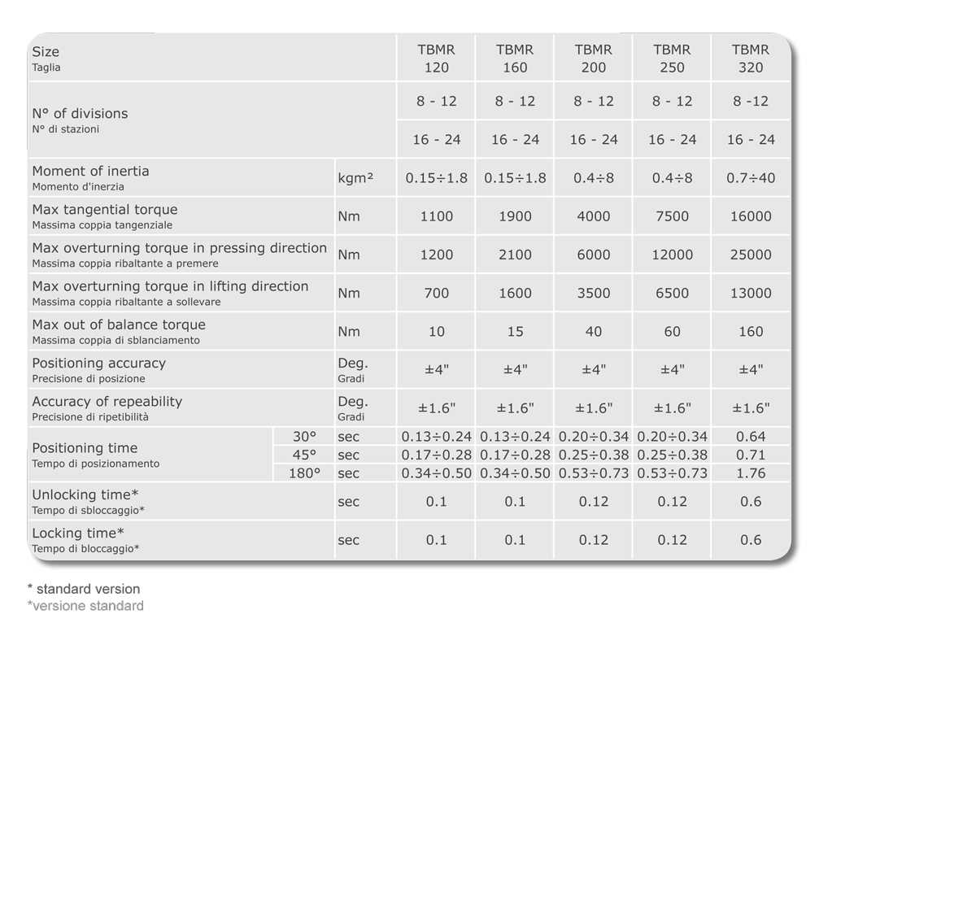
Radial driven tools turrets for tool-holders series BMT
Technical data
TBMR-BMT series
18

Slide 19
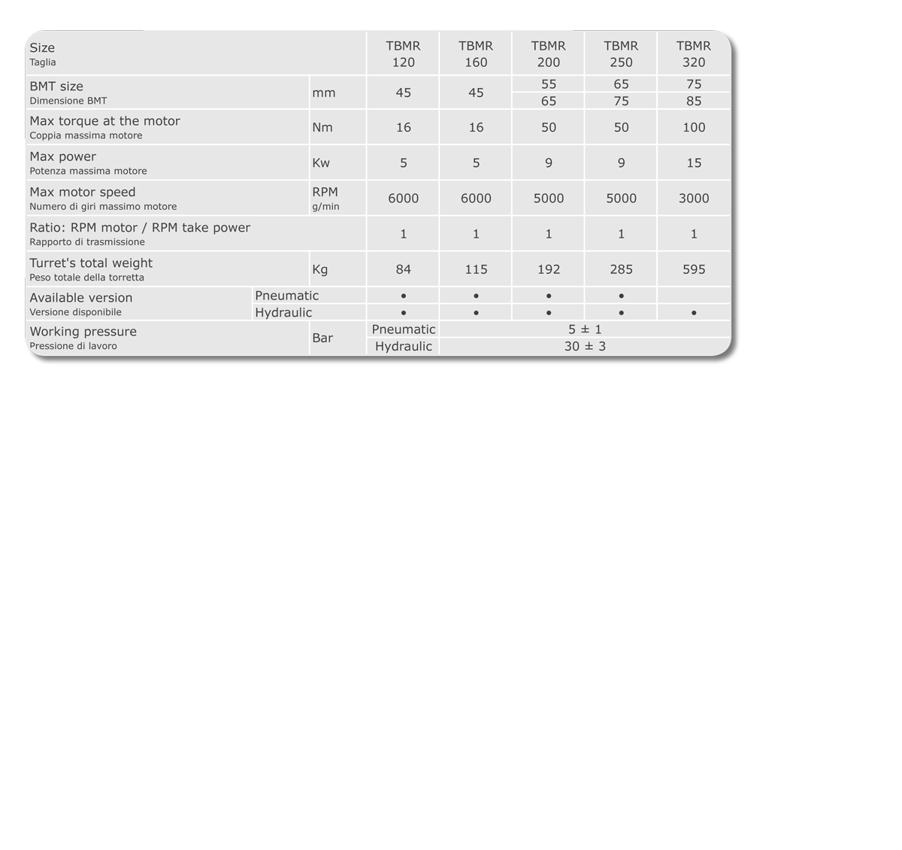
Radial driven tools turrets for tool-holders series BMT
Technical data power tools
TBMR-BMT series
19

Slide 20
Radial driven tools turrets for tool-holders series BMT
Technical section
TBMR-BMT series
20

Slide 21
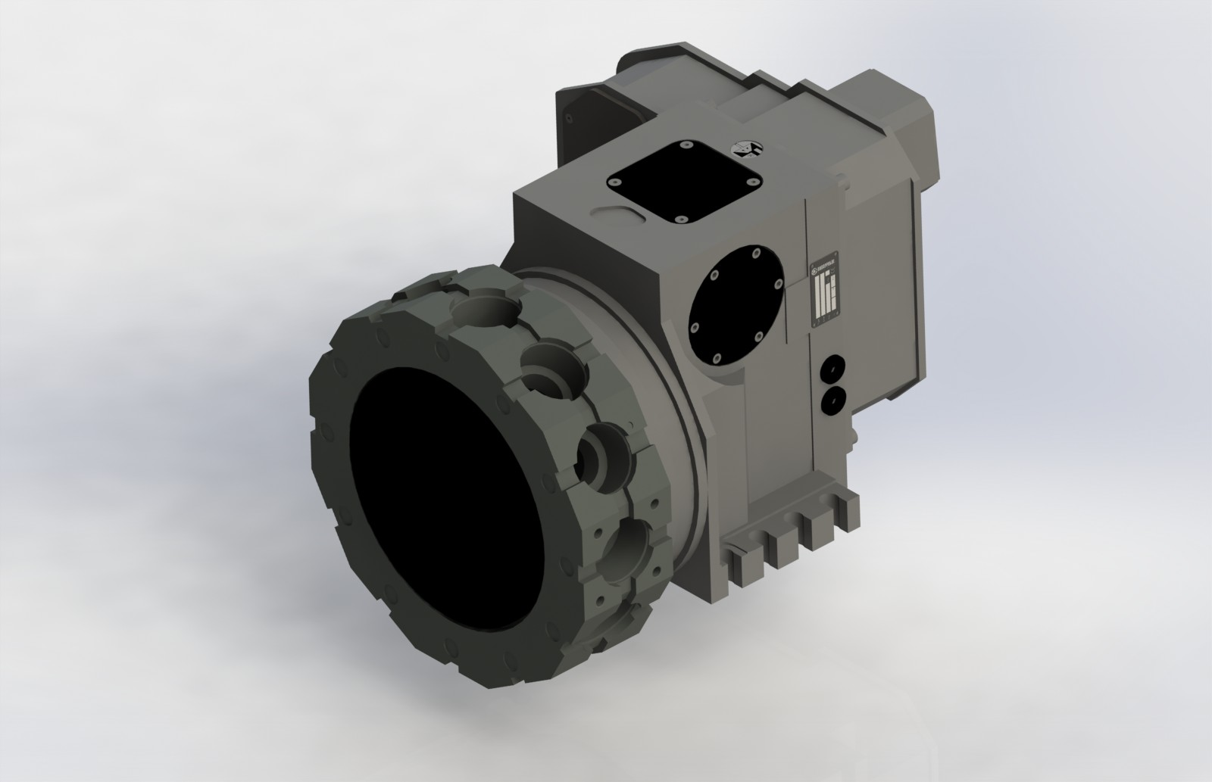
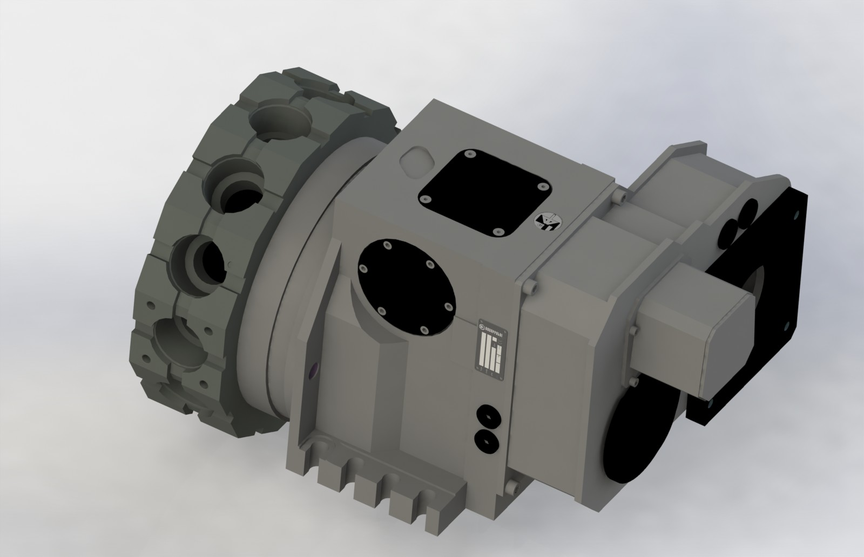
Radial driven tools turrets for tool-holders series BMT
3D view
TBMR-BMT series
21

Slide 22
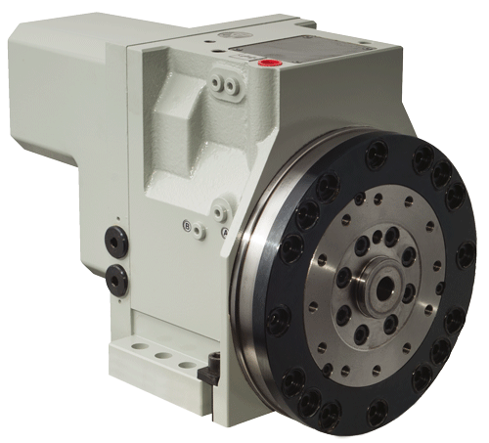
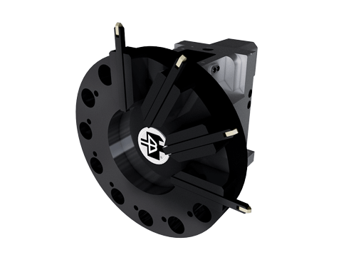
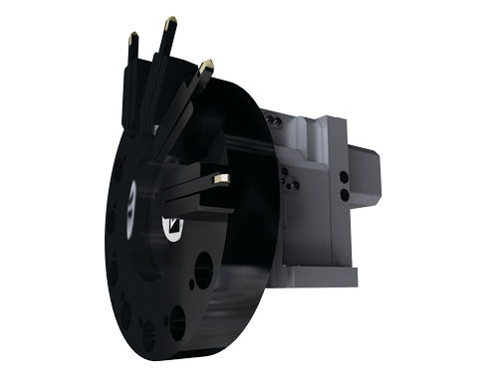
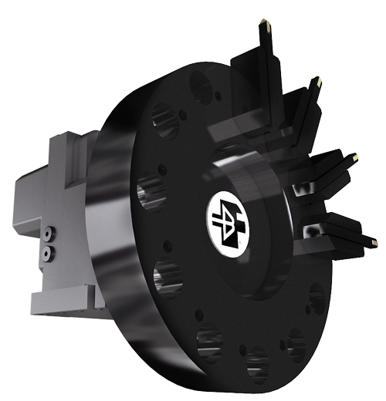
Turrets controlled by servo-motor
Description
A new line of turrets has been designed, in order to match the global competition.
They use a hydraulic locking system.
Main characteristics:
• High speed rotation
• Extremely simple design
• Minimum maintenance
An additional AC servo motor is required for the tool drive.
TBH series
22

Slide 23
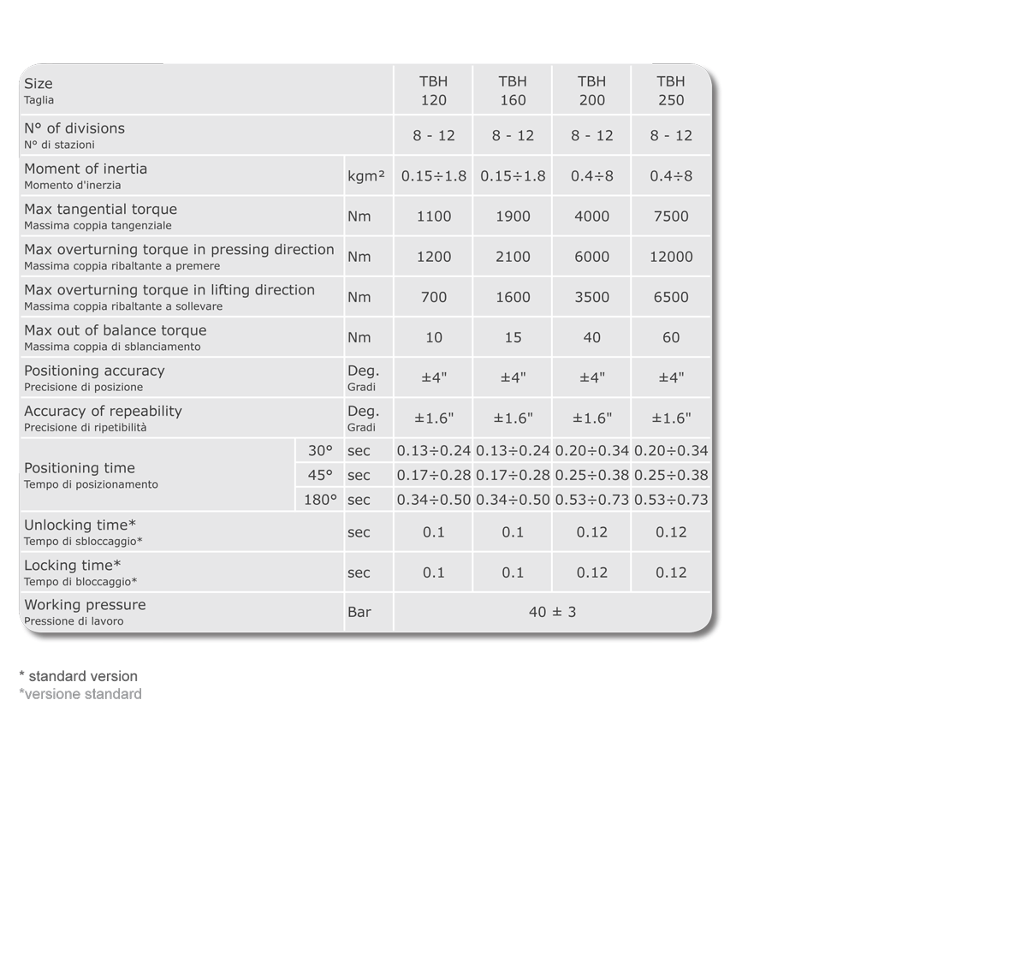
Turrets controlled by servo-motor
Technical data
TBH series
23

Slide 24
Turrets controlled by servo-motor
Technical section
TBH series
24

Slide 25
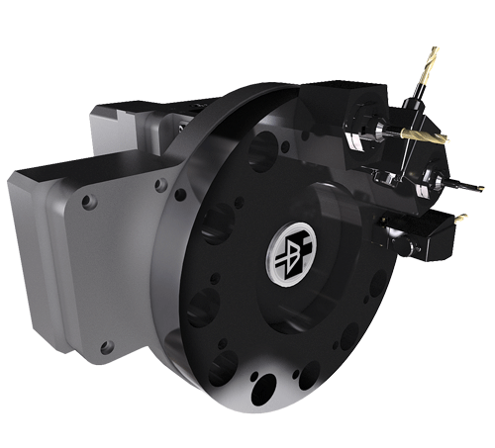
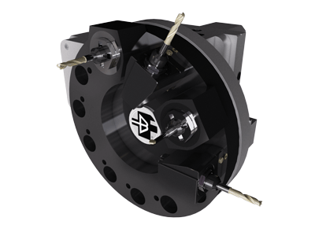
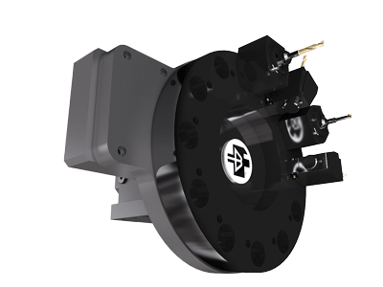
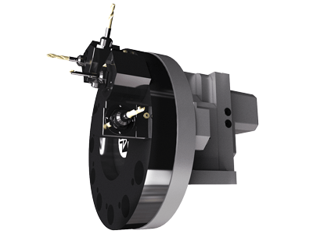
Axial driven tools hydraulic turrets for tool-holders as per ISO 10889 norms
Description
TBH turrets can be equipped with external modular driven tool system.
Only the tool in working position is driven.
No live tool clutch orientation is required, thanks to automatic engagement and disengagement, helping dead times saving.
Discs according to ISO 10889 (ex DIN 69880) norms used.
All disc positions can be used either for fixed or for live tool.
Compact overall dimensions of the driven tool system do not effect the working capacity of the lathe.
Main characteristics:
Very high rotating speed and minimum indexing
times
Locking and unlocking without axial movement
Bi-directional rotation
Oil lubrication of turret and power tool system
Double proximity switch for engagement control
High rigidity, due to the new design
Absolute positioning
Easy maintenance
TBHMA series
25

Slide 26
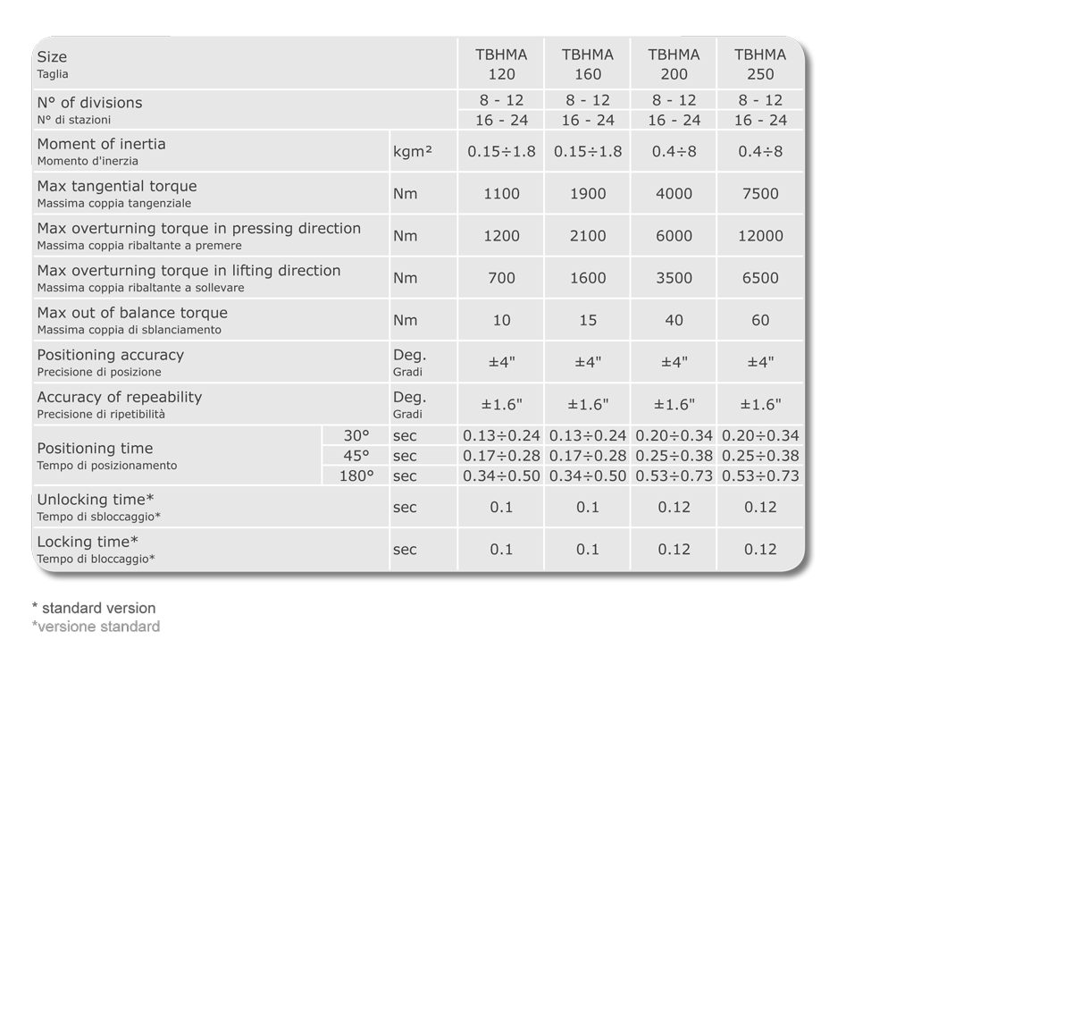
Axial driven tools hydraulic turrets for tool-holders as per ISO 10889 norms
Technical data
TBHMA series
26

Slide 27
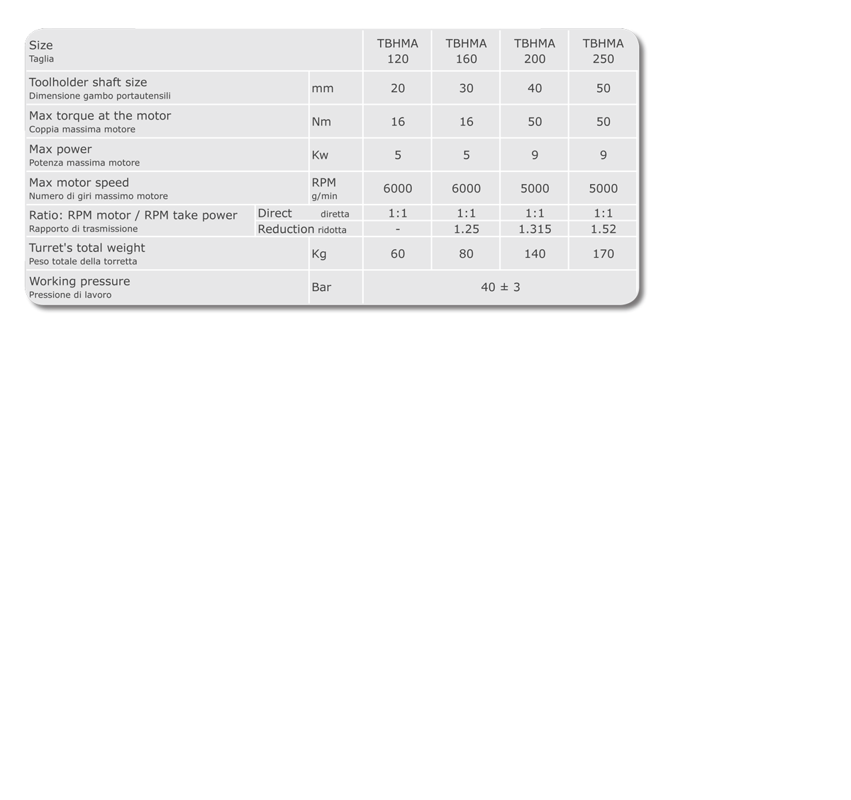
Axial driven tools hydraulic turrets for tool-holders as per ISO 10889 norms
Technical data power tools
TBHMA series
27

Slide 28
Axial driven tools hydraulic turrets for tool-holders as per ISO 10889 norms
Technical section
TBHMA series
28

Slide 29
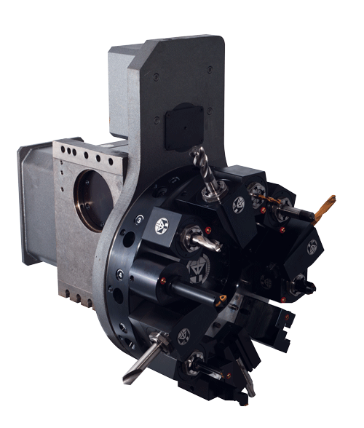
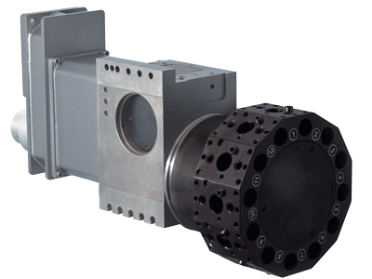
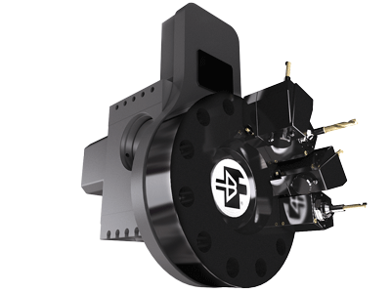
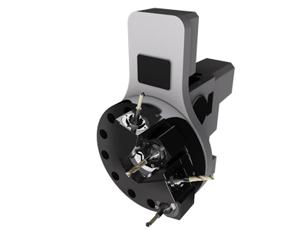
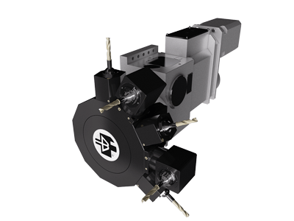
Axial and radial driven tools turrets for tool-holders as per ISO 10889 norms
Description
This turret has been designed for use on the Y axis of turning centres.
The turret has compact overall dimensions towards the chuck, the tailstock and the slide.
This solution allows use of toolholder discs with standard dimensions.
Main characteristics and advantages:
These turrets can be supplied together with Baruffaldi Y-axis unit (see YAX section), for a rugged, precise and cost-effective solution
As an alternative, such turrets can be fit on customer’s Y-axis unit
Both frontal TBYA and radial TBYR turrets can be used on the same Y-axis
Main features of these turrets are similar to TBMA and TBMR turrets
Available sizes 120-160-200-250-320.
1. For technical data refer to TBMA, TBMR-VDI and TBMR-BMT sections.
2. For Y-axis unit see YAX section.
TBYA - TBYR series
29

Slide 30
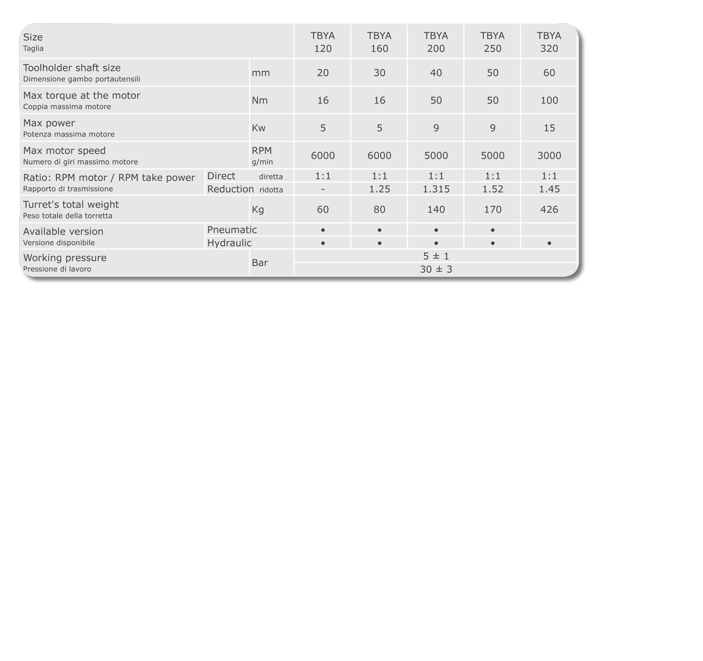
Axial and radial driven tools turrets for tool-holders as per ISO 10889 norms
Technical data power tools TBYA series
TBYA - TBYR series
30

Slide 31
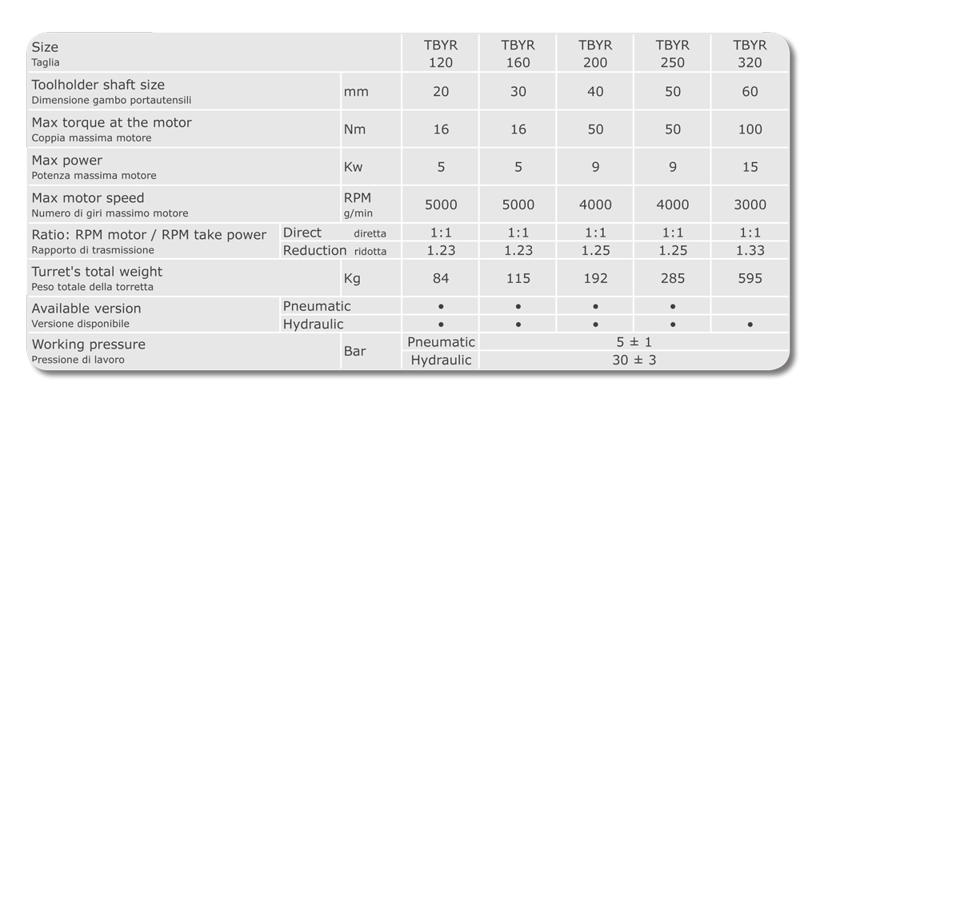
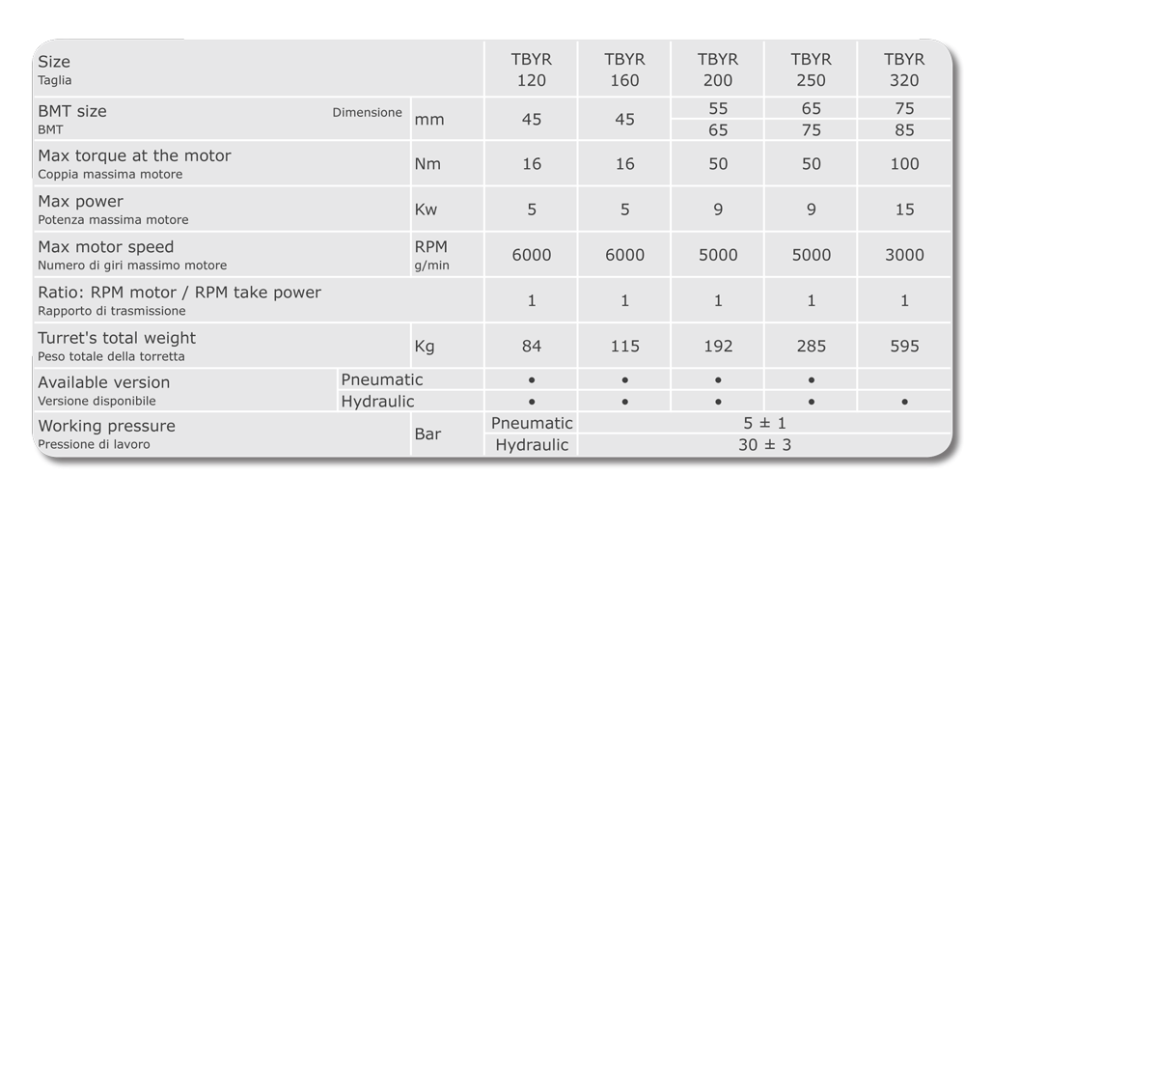
Axial and radial driven tools turrets for tool-holders as per ISO 10889 norms
Technical data power tools TBYR VDI and BMT series
TBYA - TBYR series
31

Slide 32
Axial and radial driven tools turrets for tool-holders as per ISO 10889 norms
Technical section TBYA series
TBYA - TBYR series
32

Slide 33
Axial and radial driven tools turrets for tool-holders as per ISO 10889 norms
Technical section TBYR series
TBYA - TBYR series
33

Slide 34
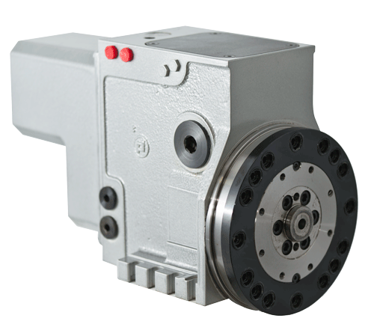
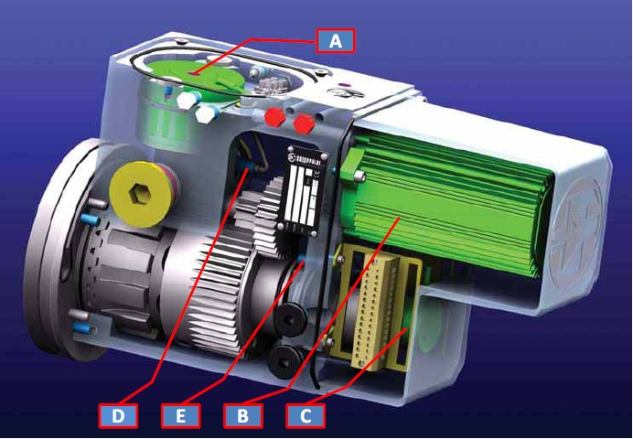
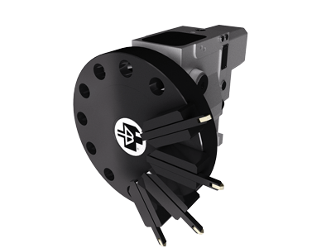
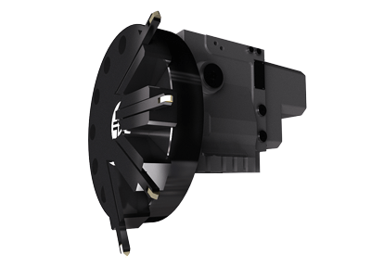
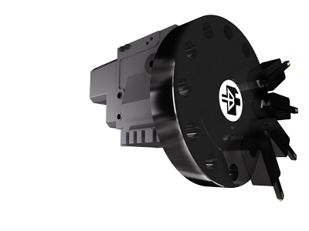
Electromechanical turrets
Description
These turrets have totally electromechanical operation both for rotation and locking.
They do not require any additional hydraulic or pneumatic component.
Main characteristics:
Very high rotating speed and minimum indexing times
Locking and unlocking without axial movement
Bi-directional rotation
A suitable system dampens the inertia of the rotating masses
High load capacity in spite of high speed
Spring locking mechanism ensures turret clamping even in the of power failure
Easy control by the interface PLC of the machine
TE series
34

Slide 35
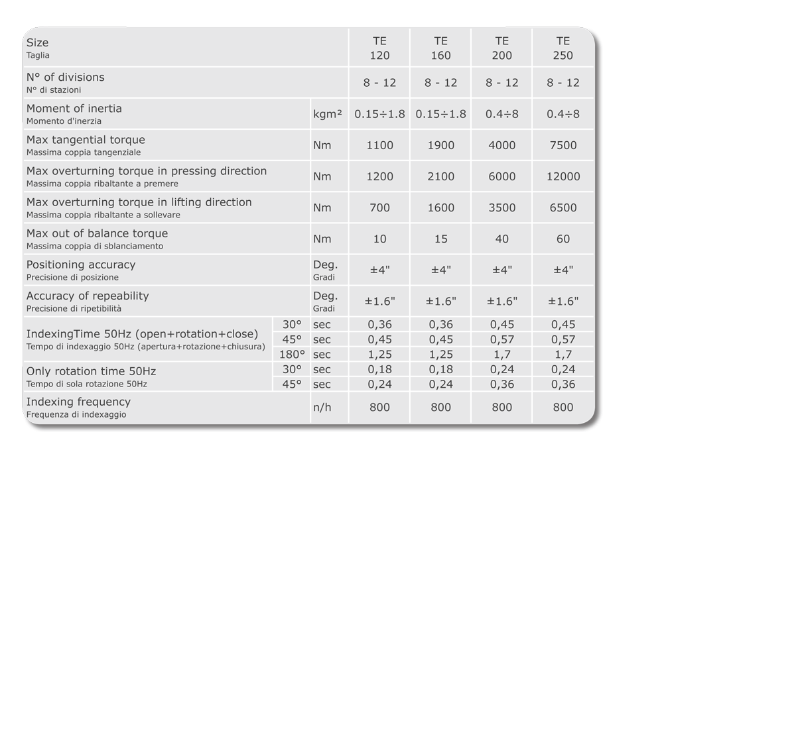
Electromechanical turrets
Technical data
TE series
35

Slide 36
Electromechanical turrets
Technical section
TE series
36

Slide 37




Electromechanical turrets
Description
TAN series turrets consist of a fixed basis ground a rotating head both made of hardened and grinded steel.
A single motor controls the phases of release, of rotation, positioning and locking.
TAN series turrets can be mounted with the axis in horizontal, vertical or slanting position.
It is possible furthermore to select any working position without stopping in the intermediate stations.
Turrets can carry 4 tools as per DIN norms 3425; on demand, they can be supplied with a different number of faces and every face is supplied with a slot for tools positioning (presetting): this allows to reduce dead times necessary for the tools presetting.
TAN series
37

Slide 38

Electromechanical turrets
Technical data
TAN series
38

Slide 39

Electromechanical turrets
Technical section
TAN series
39

Slide 40


Worldwide sales and service organIzation
Baruffaldi has developed a sales and service organisation all over the world.
Furthermore, thanks to a net of agents and distributors, it is ensured a direct contact in many nations.
Baruffaldi
Machine tool components
Via Cristoforo colombo, 4 20090 Settala (MI) - ITALY Tel. +39 02 906090
Fax +39 02 906090015 sales.baruffaldi@baruffaldi.it
Registered Office
Via Cassino d’Alberi, 16 20067 Tribiano (MI) - ITALY Tel. +39 02 906090
Fax +39 02 906090014
40

